Slide 1
Databases: DBMS & RDBMS (H17H 34)
Part C.

Slide 2
Outline
Database – Intro
XML & Flat Files
Database Management System (DBMS)
Relational Database Management System (RDBMS)
E-R Model Systems
Data Normalisation
RDBMS Practical Session – Learning MS Access
Mini-Project – Setup MS Assess RDBMS

Slide 3
Part. C: DBMS & RDBMS

Slide 4
Databases – DBMS & RDBMS
DBMS – Database Management System
RDBMS – Relational Database Management System

Slide 5
Database Management System (DBMS)

Slide 6
What Are Database Management System (DBMS)?
Software tools that enable the management (definition, creation, maintenance and use) of large amounts of interrelated data stored in a computer accessible media.
This may also refer to sets of operations performed within a typical database.
add, remove, update records
retrieve data that match certain criteria
cross-reference data in different tables
perform complex aggregate calculation
A database management system (DBMS) is a collection of programs that enables users to create and maintain a database.
DBMS is the intermediary between the user and the database
Database structure stored as file collection
Can only access files through the DBMS
According to the ANSI/SPARC DBMS Report (1977), a DBMS should be envisioned as a multi-layered system:

Slide 7
Functions & Applications of Database Management Systems (DBMS)
Manage persistent data
Access large amounts of data efficiently
Support for at least one data model
Support for certain high-level language that allow the user to define the structure of the data, access data, and manipulate data
Transaction management – the capability to provide correct, concurrent access to the database by many users at once
Access control – the ability to limit access to data by unauthorized users, and the ability to check the validity of data
Resiliency – the ability to recover from system failures without losing data
Allow concurrency
Control security
Maintain data integrity
Provide for backup and recovery
Control redundancy
Allow data independence
Provide non-procedural query language
Perform automatic query optimization
Data transformation and presentation
Security management
Multi-user access control
Data backup and recovery management
Data integrity management

Slide 8
Who Interacts with a DBMS?
Many different individuals are involved with a database management system over its life.
These include;
Systems analysts
Database designers
Database administrators
Application developers
End users

Slide 9
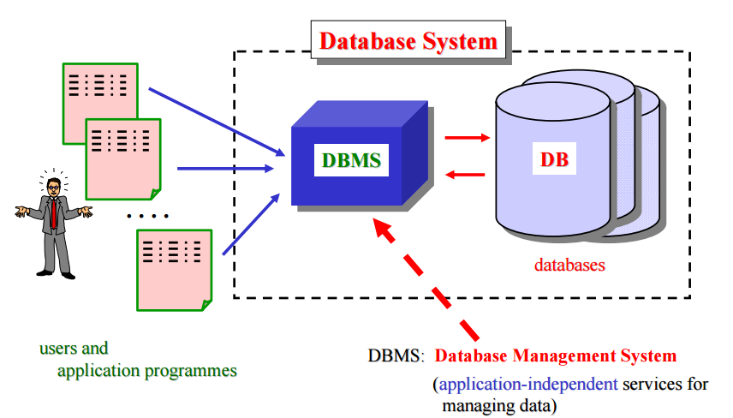
Schematic of DBMS

Slide 10
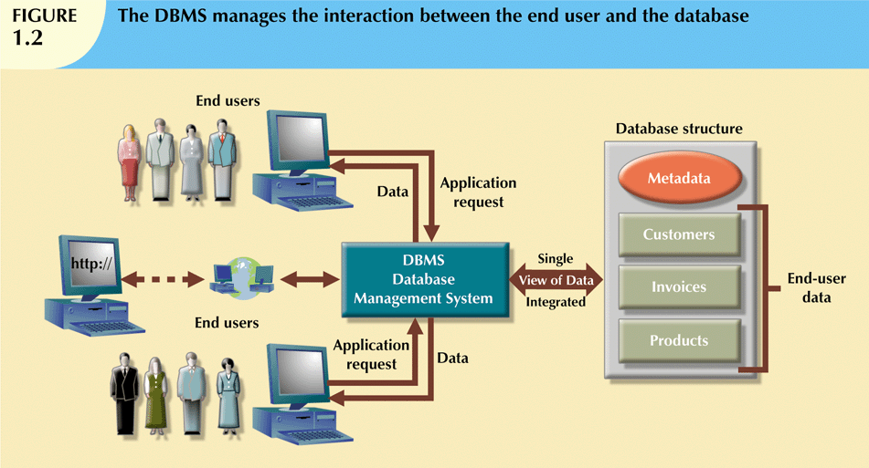
Schematic of DBMS

Slide 11
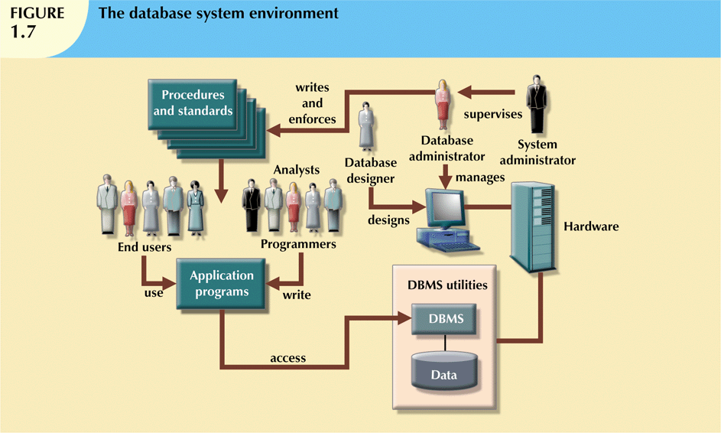
Components of a DBMS
There are five major parts that constitute a Database Management System (DBMS) components.
These include;
Hardware
Software
People/users
Procedures
Data
Tables

Slide 12
Components of a DBMS
Hardware: All the system’s physical devices
Software: Three types of software required:
Operating system software
DBMS software (e.g. Microsoft Access)
Application programs and utility software
People: All users of the database system
System and database administrators
Database designers
Systems analysts and programmers
End users
Procedures: Instructions and rules that govern the design and use of the database system
Data: The collection of facts stored in the database

Slide 13
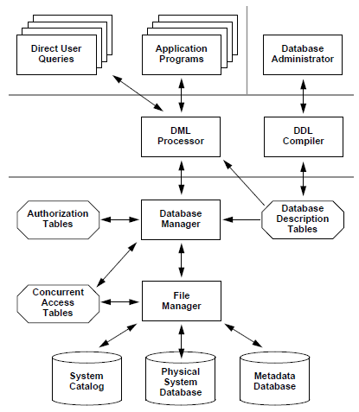
Component of a Database System

Slide 14
Relational Database Management System (RDBMS)

Slide 15

Introduction
The idea to investigate data representation by means of the theory of relations was first developed and proposed in 1960 by Edgar F. Codd.
Edgar published his first paper (A Relational Model of Data for Large Shared Data Banks) in 1970, in which he fixed all foundations of relational databases with amazing precision and clarity.
Edgar Codd died in early 2003

Slide 16
What Are Relational Databases?
The notion "relational" is motivated by the mathematical concept of a relation. Relations in mathematics are sets of tuples.
Relational databases are collections of one or more relations.
A relational DB may also be defined as a database that treats all of its data as a collection of relations.
In practice, relations can be visualised as Tables (Tables – the rows of which are individual records of data with the same field structures)
What is a Relation?
Relation can be regarded as tables
Relation can also be considered sets which can in turn consist of subsets
A Set – refer to the collection of data belonging to similar class.
Example of Sets
A = { 1,2,3,4,5,6 }
B = { H,T }
C = { R,B }
D = { Grant, Sherman, Lee }
Question:
What is the difference between Sets & Arrays

Slide 17
Commercial Database Management (RDBMS) Products
Microsoft (Access, SQL Server)
Oracle RDBMS
IBM (DB2, Informix)
MySQL (Freeware)
Postgres (Freeware)
Sybase

Slide 18
When Not To Use Databases
Costs of using a DBMS:
High initial investment and possible need for additional hardware.
Overhead for providing generality, security, concurrency control, recovery, and integrity functions.
When a DBMS may be unnecessary:
If the database and applications are simple, well defined, and not expected to change.
If there are stringent real-time requirements that may not be met because of DBMS overhead.
If access to data by multiple users is not required.
When no DBMS may suffice:
If the database system is not able to handle the complexity of data because of modeling limitations
If the database users need special operations not supported by the DBMS.

Slide 19
Resources for Further Reading/Research
https://www.sqa.org.uk/e-learning/SoftDevRDS01CD/page_15.htm
https://www.thoughtco.com/databases-4133458
https://www.youtube.com/watch?v=4Z9KEBexzcM&list=PLXvbNfcYjXS0OUErHhkZdEENmz12DuxyH

